Slide 1
Cross - platform event management app
TANUJA P
192321052
Dr K Ramesh kumar
Department of Nxt-Gen Computing

Slide 2
Introduction
Unified Experience Across Devices: The app provides a seamless user experience on Android, iOS, and web platforms, allowing users to access and manage events from any device.
Event Creation and Customization: Users can easily create, edit, and personalize events with options for themes, reminders, RSVPs, and ticketing.
Real-Time Notifications and Updates: Instant alerts keep users informed about schedule changes, attendee updates, and announcements to ensure everyone is on the same page.
Integrated Communication Tools: Built-in chat, email integration, and calendar syncing enhance coordination between organizers and attendees.
Analytics and Feedback System: Organizers can track event performance, attendance rates, and gather post-event feedback to improve future events.

Slide 3
Objective
To provide a centralized platform for organizing, scheduling, and promoting events accessible from any device or operating system.
To enhance user collaboration by enabling real-time updates, participant interactions, and feedback collection within the app.
To simplify event logistics through features like automated reminders, RSVP tracking, and venue management.
To ensure data security and privacy by implementing secure login, encrypted storage, and role-based access control.
To support scalability and adaptability by allowing the app to cater to both small personal events and large-scale professional conferences.

Slide 4
Methodology used
Front-End Development: The user interface of the application was developed using HTML, CSS, and JavaScript to ensure a responsive and user-friendly experience across devices.
Backend and Hosting Environment: The app's data handling and basic functionalities were managed using XAMPP, which provided a local server environment for development and testing.
Web Deployment: After development, the website was hosted online using InfinityFree, a free hosting service that enabled the app to be accessed publicly via a domain.
App Conversion: The hosted website was converted into a mobile application using Appilix, a no-code platform that wraps web applications into installable Android apps.
Cross-Platform Accessibility: This approach allowed the app to function across platforms — accessible via web browsers and as a standalone mobile app

Slide 5
Result and Discussion
Successful Development and Deployment: The event management website was successfully developed using HTML, CSS, and JavaScript, and deployed using InfinityFree. It was accessible on both desktop and mobile browsers without any major performance issues.
Functional Mobile App Conversion: Using Appilix, the hosted website was effectively converted into a mobile application (APK). The app maintained full functionality, including user registration, event creation, and navigation, confirming successful cross-platform operation.
Limitations and Challenges:
. Limited offline access and no push notification support in the converted mobile app.
Appilix-generated app had restrictions on background services and deeper mobile integration (e.g., file access, notifications).
Future Improvements:
Integrating a real-time database (e.g., Firebase or MySQL with PHP backend).
Adding offline access and background sync.

Slide 6
Sample Code
<header class="sticky-header">
<div class="logo">EventEase</div>
<nav>
<ul>
<li><a href="./dashboard.html">Home</a></li>
<li><a href="event.html">Event</a></li>
<li><a href="#about">About Us</a></li>
<li><a href="#contact">Contact</a></li>
</ul>
</nav>
</header>
<section class="hero">
<h1>Welcome to EventEase</h1>
<p>Seamlessly plan your perfect event, effortlessly.</p>
<a href="event.html" class="btn">Explore Event</a>
</section>
<section class="popular">
<h2>Our Event Services</h2>
<div class="dish-grid">
<div class="dish">
<img src="e plan.jpg" alt="Event Planning" />
<div class="dish-info">
<h3>Event Planning</h3>
<p>Perfectly tailored events to suit your</p>
</div>
</div>
<div class="dish">
<img src="https://images.unsplash.com/photo-1550547660-d9450f859349" alt="Catering" />
<div class="dish-info">
<h3>Catering</h3>
<p>Delicious food for your guests</p>
</div>
</div>

Slide 7
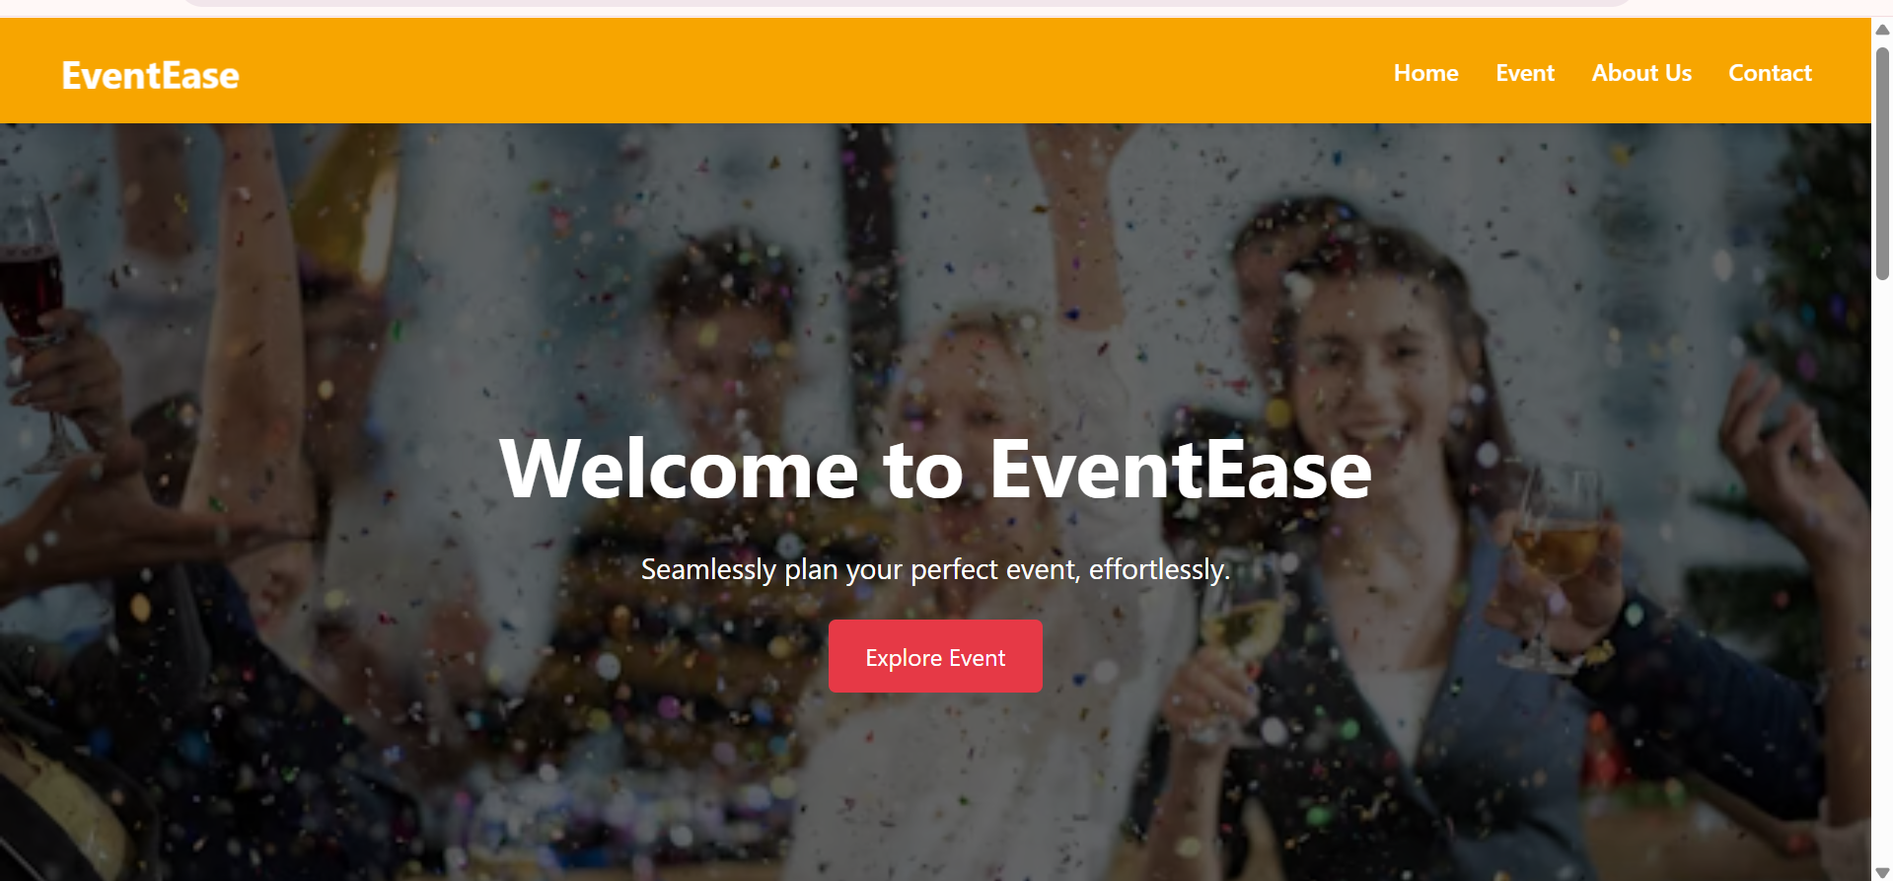
Sample Output Screen

Slide 8
Conclusion
The app was successfully developed using HTML, CSS, and JavaScript and deployed via InfinityFree for online access.
The website was effectively converted into a mobile app using Appilix, enabling cross-platform accessibility.
Core features like event creation, user registration, and responsive UI were implemented and functioned as expected.
The project demonstrated a cost-effective way to build and distribute apps using web-to-app conversion tools.
Some limitations were identified, including lack of real-time backend support, offline access, and limited native features.
Overall, the project serves as a working prototype with potential for future improvements like database integration, offline sync, and push notifications.

Slide 9
References
W3Schools. (n.d.). HTML, CSS, and JavaScript Tutorials. Retrieved from https://www.w3schools.com
Apache Friends. (n.d.). XAMPP - Apache + MariaDB + PHP + Perl. Retrieved from https://www.apachefriends.org
phpMyAdmin. (n.d.). phpMyAdmin - MySQL Web Interface. Retrieved from https://www.phpmyadmin.net
InfinityFree. (n.d.). Free Website Hosting Service. Retrieved from https://www.infinityfree.net
Appilix. (n.d.). Convert Website to Android App Online. Retrieved from https://www.appilix.com
MDN Web Docs. (n.d.). JavaScript and Web APIs Documentation. Retrieved from https://developer.mozilla.org

